Slide 1



Making the most of what we’ve got why we need an Australian Creative Archive
Jessica Coates
Project Manager
Creative Commons Clinic
January 2009
CRICOS No. 00213J

Slide 2


The Problem
the internet makes much more possible
but only if we have material to work with
v hard for Australians to find legal sources of local material for remixing
The Solution
our national collections have the potential to fill this gap
sure there are costs for digitising etc – but cheaper than creating this material from scratch
CRICOS No. 00213J
Notes:
The open access movement is in a better place than its ever been before, as far as gaining ‘mainstream’ acceptance and being adopted by large players
There have, of late, been lots of official statements endorsing open access – from the OECD, from Venturous Australia etc

Slide 3
the traditional model
on-site access provided on a fair dealing basis
‘access’ charges for off-site access and re-use the material
everything decided case-by-case basis
inefficient
costly
inconsistent
CRICOS No. 00213J
Notes:
The open access movement is in a better place than its ever been before, as far as gaining ‘mainstream’ acceptance and being adopted by large players
There have, of late, been lots of official statements endorsing open access – from the OECD, from Venturous Australia etc

Slide 4
it’s already happening
many archives are doing this already
dozens of great sources of images etc
early days yet, but starting to get movement in books and audiovisual
it’s still illegal to use most of this material - without going through the same cumbersome clearance processes
CRICOS No. 00213J
Notes:
The open access movement is in a better place than its ever been before, as far as gaining ‘mainstream’ acceptance and being adopted by large players
There have, of late, been lots of official statements endorsing open access – from the OECD, from Venturous Australia etc

Slide 5
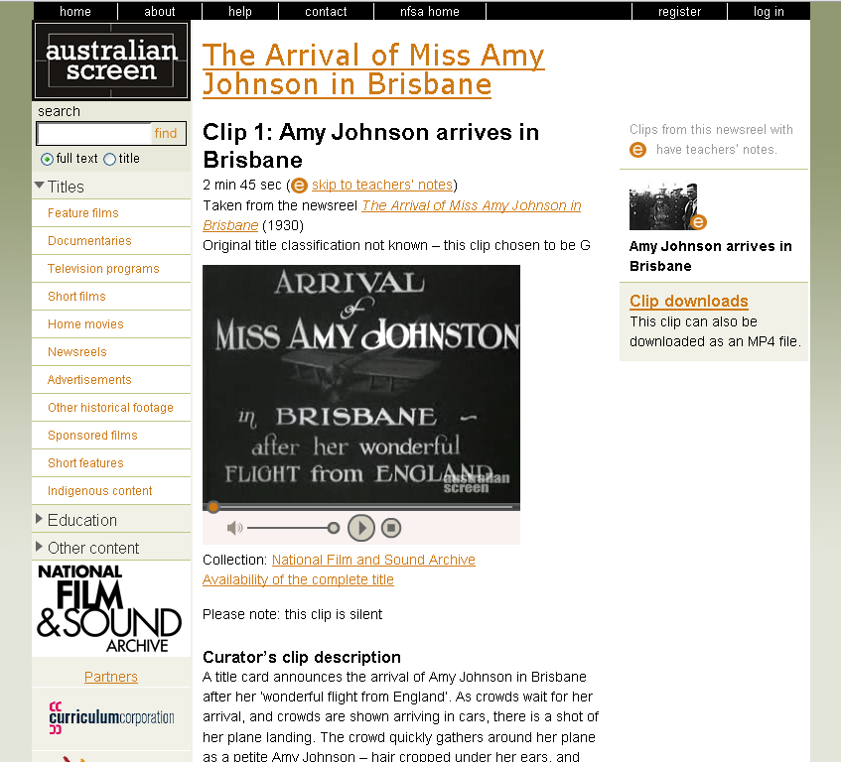
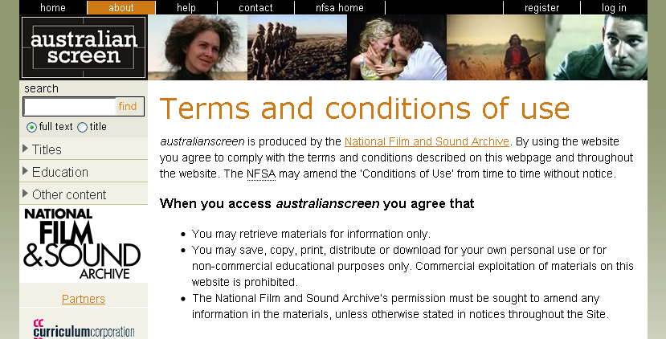
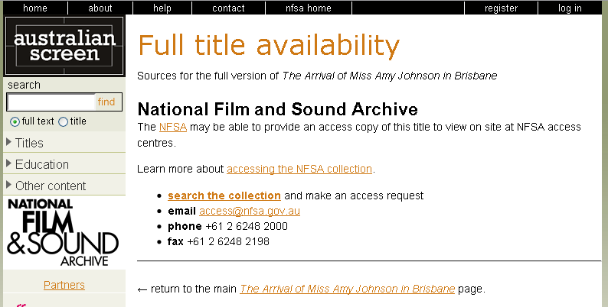
This is particularly frustrating when the material is in the public domain . . .
CRICOS No. 00213J
Notes:
The open access movement is in a better place than its ever been before, as far as gaining ‘mainstream’ acceptance and being adopted by large players
There have, of late, been lots of official statements endorsing open access – from the OECD, from Venturous Australia etc

Slide 6
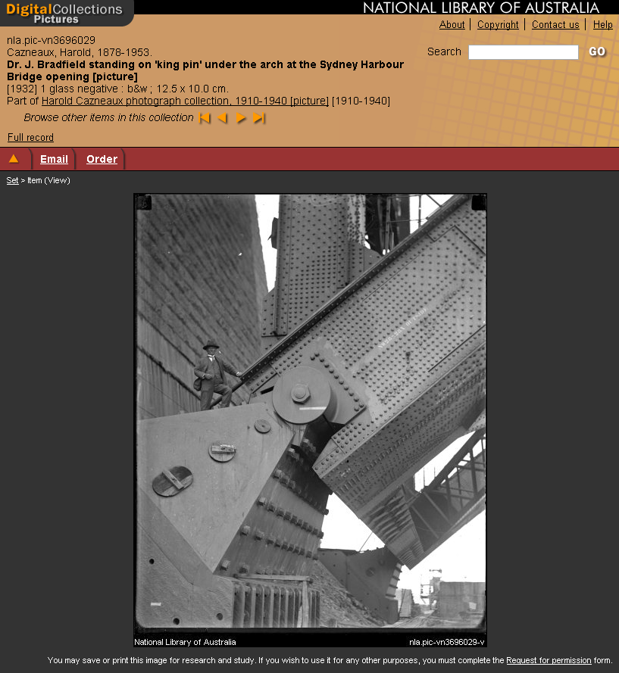
when it’s in response to a specific inquiry . . .
CRICOS No. 00213J
Notes:
The open access movement is in a better place than its ever been before, as far as gaining ‘mainstream’ acceptance and being adopted by large players
There have, of late, been lots of official statements endorsing open access – from the OECD, from Venturous Australia etc

Slide 7
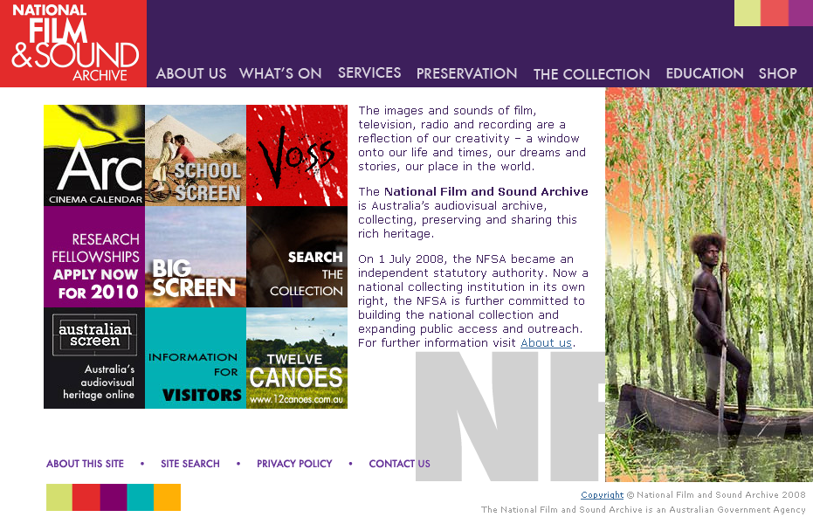
when they want to charge you for it . . .
As is international archival practice, we charge usage fees on items that have been preserved by us. This, in a very small way, is designed to help offset the costs of obtaining, copying, preserving and storing the item.
CRICOS No. 00213J
Notes:
The open access movement is in a better place than its ever been before, as far as gaining ‘mainstream’ acceptance and being adopted by large players
There have, of late, been lots of official statements endorsing open access – from the OECD, from Venturous Australia etc

Slide 8
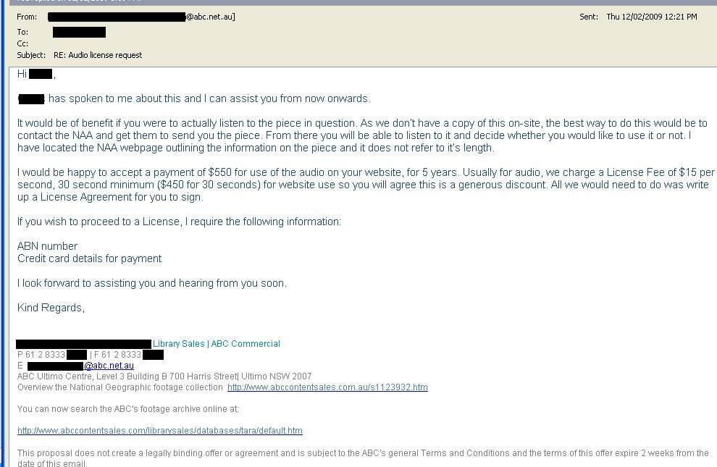
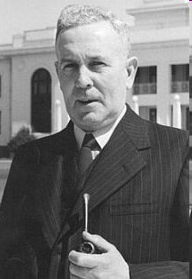
or when it’s funded and owned by tax payers
(and in the public domain and they want to charge you)
CRICOS No. 00213J
Notes:
The open access movement is in a better place than its ever been before, as far as gaining ‘mainstream’ acceptance and being adopted by large players
There have, of late, been lots of official statements endorsing open access – from the OECD, from Venturous Australia etc

Slide 9
why?
orphaned works
under-rating the public domain
cost of copyright clearance
politics with contributors
cost of digitisation
risk aversion
control
protection of revenue streams
asset tracking
lack of expertise
CRICOS No. 00213J
Notes:
The open access movement is in a better place than its ever been before, as far as gaining ‘mainstream’ acceptance and being adopted by large players
There have, of late, been lots of official statements endorsing open access – from the OECD, from Venturous Australia etc

Slide 10
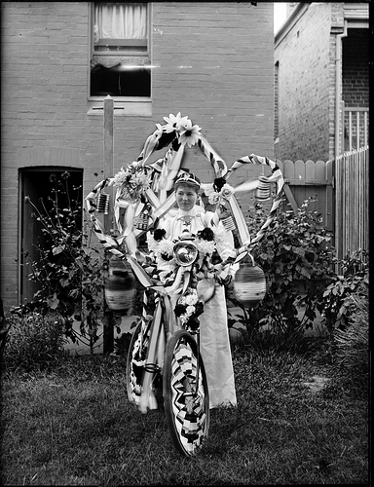
Powerhouse Museum
Flickr Commons – initially released 200 photographs, now over 1500
‘Play’ worksheets available under CC
encouraged CC for ‘photo of the day’
collections descriptions and data under CC
identified ‘easy’ material – public domain, new acquisitions and material owned by PHM
examined business models, to see when OA was appropriate
teamed with an existing programs (educational workshops) and providers (Flickr)
Woman holding decorated bicycle, Phillips Glass Plate Negative Collection, Powerhouse Museum, www.powerhousemuseum.com/
collection/database/collection=Phillips_Glass_Plate_Negative
CRICOS No. 00213J
Notes:
The open access movement is in a better place than its ever been before, as far as gaining ‘mainstream’ acceptance and being adopted by large players
There have, of late, been lots of official statements endorsing open access – from the OECD, from Venturous Australia etc

Slide 11
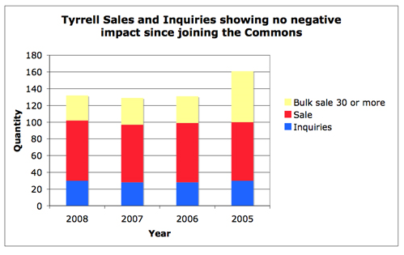
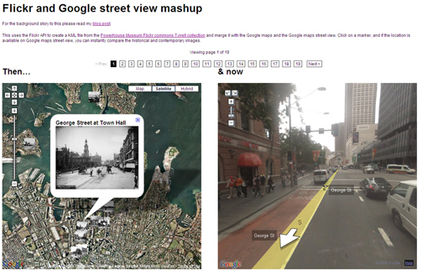
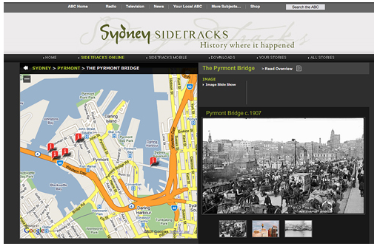
PHM benefits
increased visitation of material – 5,000 views in first day, 20x increase projected
valuable tagging and comments – integrated into museum’s metadata
promotion
innovation
research
community engagement
discoveries
partnerships
reduced costs for Australian community (particularly schools)
didn’t hurt sales
Open Licensing and the Future for Collections, Paula Bray, Manager Image Services, Powerhouse Museum, Sydney, Australia http://www.archimuse.com/mw2009/papers/bray/bray.html
promotional + other benefits ~ neutral effect on sales = net +ve $
CRICOS No. 00213J
Notes:
The open access movement is in a better place than its ever been before, as far as gaining ‘mainstream’ acceptance and being adopted by large players
There have, of late, been lots of official statements endorsing open access – from the OECD, from Venturous Australia etc

Slide 12
don’t just believe me
1. Resources should be made available for reuse unless there is a justifiable reason why they should not.
2. The reuse of resources should be as unconstrained as possible. For example, resources should be made available for commercial reuse as well as non-commercial reuse wherever possible.
3. The range of permitted uses of resources should be as wide as possible, for example, including the right to modify the resource and produce derivative works from it.
- Common Information Environment
[To] Foster creativity in the development, use and application of the Internet, through policies that . . . make public sector information and content, including scientific data, and works of cultural heritage more widely accessible in digital format.
- OECD Seoul Declaration
To the maximum extent practicable, information, research and content funded by Australian governments – including national collections – should be made freely available over the internet as part of the global public commons.
– Venturous Australia Report
There is the potential to release huge quantities of information for re-use by innovators in SMEs, the third sector and even big business. . . Public information does not belong to Government, it belongs to the public on whose behalf government is conducted
- UK Power of Information Taskforce Report
As a guiding principle, information produced by public entities in all branches and at all levels should be presumed to be available to the public
- UNESCO Policy Guidelines for the Development and Promotion of Governmental Public Domain Information
CRICOS No. 00213J
Notes:
The open access movement is in a better place than its ever been before, as far as gaining ‘mainstream’ acceptance and being adopted by large players
There have, of late, been lots of official statements endorsing open access – from the OECD, from Venturous Australia etc

Slide 13
so what should we do?
1. Resources should be made available for reuse unless there is a justifiable reason why they should not.
2. The reuse of resources should be as unconstrained as possible. For example, resources should be made available for commercial reuse as well as non-commercial reuse wherever possible.
3. The range of permitted uses of resources should be as wide as possible, for example, including the right to modify the resource and produce derivative works from it.
- Common Information Environment
[To] Foster creativity in the development, use and application of the Internet, through policies that . . . make public sector information and content, including scientific data, and works of cultural heritage more widely accessible in digital format.
- OECD Seoul Declaration
To the maximum extent practicable, information, research and content funded by Australian governments – including national collections – should be made freely available over the internet as part of the global public commons.
– Venturous Australia Report
There is the potential to release huge quantities of information for re-use by innovators in SMEs, the third sector and even big business. . . Public information does not belong to Government, it belongs to the public on whose behalf government is conducted
- UK Power of Information Taskforce Report
As a guiding principle, information produced by public entities in all branches and at all levels should be presumed to be available to the public
- UNESCO Policy Guidelines for the Development and Promotion of Governmental Public Domain Information
CRICOS No. 00213J
Notes:
The open access movement is in a better place than its ever been before, as far as gaining ‘mainstream’ acceptance and being adopted by large players
There have, of late, been lots of official statements endorsing open access – from the OECD, from Venturous Australia etc

Slide 14

Thanks
http://www.creativecommons.org
http://www.creativecommons.org.au
info@creativecommons.org.au
Unless otherwise noted, this slide show is licensed under a Creative Commons Australia Attribution licence. For more information see http://creativecommons.org/licenses/by/2.5/au/.
CRICOS No. 00213J

